Slide 1
Using Search capabilities with app model
Name
Title
Company

Slide 2
Agenda
Search Building Blocks
Extending Search Center
Overview
Search Based Apps

Slide 3
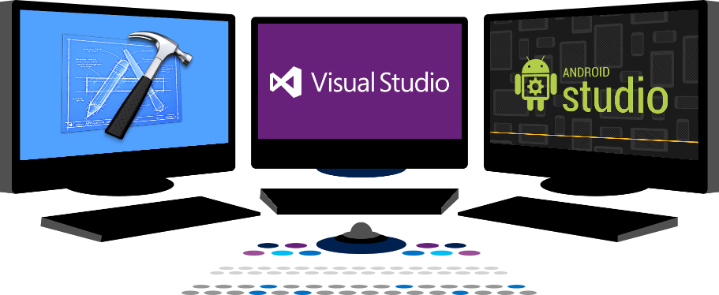














Vision
EXTEND OFFICE EVERYWHERE
CONNECT TO OFFICE 365 SERVICES
BUILD USING AN OPEN PLATFORM
Delve
z
Users and groups
Files
Mail
Calendar
My Apps
Video Portal
Contacts
Office Graph
Presentations
Documents
Spreadsheets
Lync
OneNote
Yammer

Slide 4
Recommendations
Exporting and importing search settings with CSOM
Out of the box capabilities can be easily extended
Display templates are really powerful
Remote APIs for customizations

Slide 5
Overview

Slide 6



Search App Building Blocks
SharePoint Apps
Databases
C#
LOB System
SharePoint
REST
CSOM
SharePoint API
Service applications
List and Libraries
Managed metadata
Search Service
Workflow Service
BCS

Slide 7
Search Service Value
Single service application for locating documents, people, and data within SharePoint
Extend the OOB Search Center to create unique solutions with customized results, displays, and functionality
Use the Search API to incorporate search functionality in SharePoint apps

Slide 8
Search Building Blocks

Slide 9
Building Blocks
Managed Properties
Result Sources
Query Rules
Result Types
Search Navigation

Slide 10
Managed Properties
Mapped to Crawled Properties
Tenancy level
Site Collection level
Site Columns Become Managed Properties
Publishing and Multiple Lines prefixed with ows_r_<four-letter-code>
Managed Metadata prefixed with ows_taxId
All others prefixed with ows_q_<four-letter-code>

Slide 11
Managed Properties
Property | Description
Queryable | Managed Property can be used in property-based searches
Refinable | Managed Property can be used as a refiner
Retrievable | Managed Property can be returned in the results
Searchable | Includes the value of the Managed Property in the Search Index
Sortable | Managed Property can be used for sorting results
Type | The data type of the Managed Property
Safe | Can be returned to anonymous users
Alias | Friendly names
Multi-valued | Managed Property can have multiple values
Notes:
Tenant
SSA
Site Collection level

Slide 12
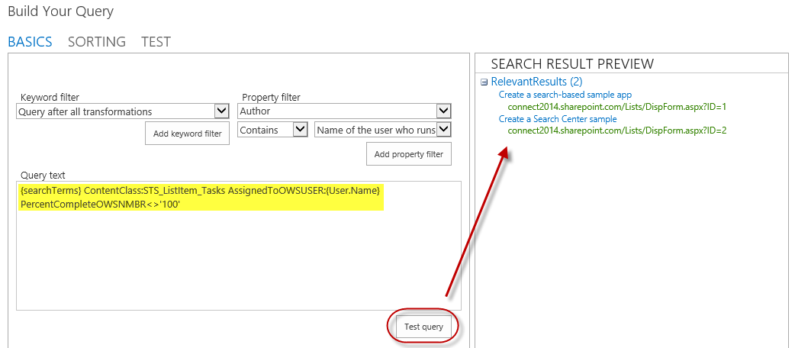
Result Sources
Select a Source
Local SharePoint Index
Remote SharePoint Index
OpenSearch
Exchange
Apply a Query Transformation
Defines a subset of the source

Slide 13
Query Rules
Applied to a given Result Source
Processed under specified conditions
Keyword match
Topic category match
Affects the query results
Alter the user’s query
Generate a Result Block

Slide 14
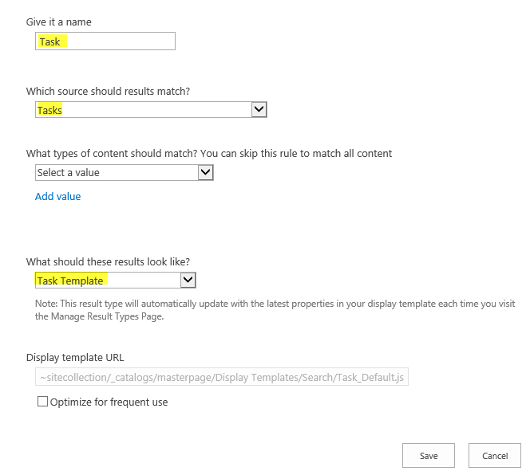
Result Types
Bound to a given Result Source
Defined by a rule
Associated with a template for display
Determines how Result Type appears
Created as an HTML file referencing Managed Properties

Slide 15
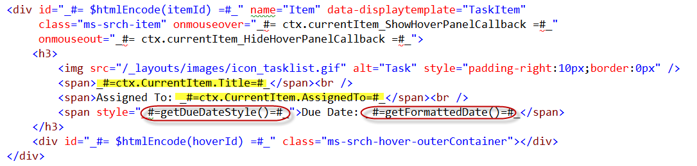
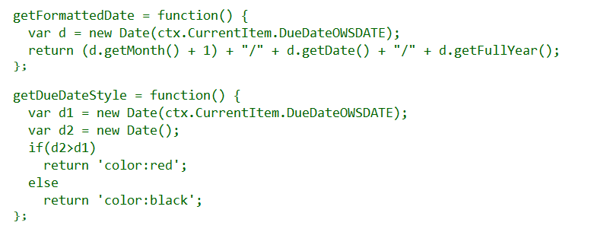
Display Templates

Slide 16
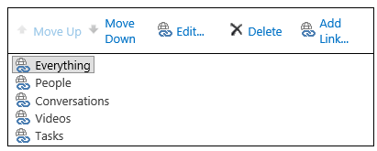
Search Navigation
Provides navigation across pages in Search Center

Slide 17
Export/Import Search Settings
Configuration export
SearchConfiguration.xml
Handles rules, sources, managed properties, etc.
Does not handle master pages, templates, and web parts
Configuration import
Import into site, site collection, tenancy
Programmatically import with app

Slide 18
Export/Import Search Settings
Demo
https://github.com/OfficeDev/PnP/tree/master/Samples/Core.SearchSettingsPortability

Slide 19
Calling Search using CSOM
Demo
https://github.com/OfficeDev/PnP/tree/master/Samples/Search.PersonalizedResults

Slide 20
Extending Search Center

Slide 21
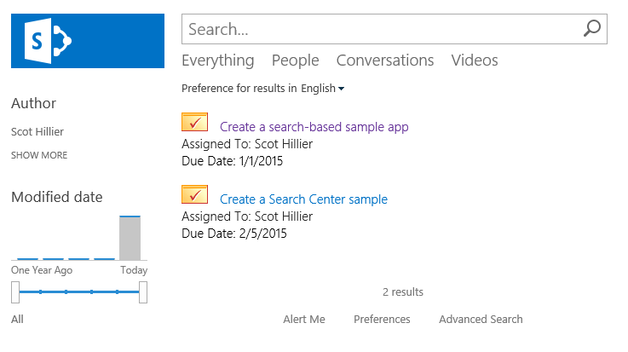
Custom Search Results
Use building blocks to create custom solutions in Search Center

Slide 22
Automating Search Center Modifications
Use App Installed Event to trigger modifications
Activating features
Uploading display templates
Manipulating web part properties
Include exported search configurations in apps
Add new “Search Configuration” to app

Slide 23
Activating Features
//Enable Publishing Infrastructure Feature
Guid id = new Guid("{F6924D36-2FA8-4f0b-B16D-06B7250180FA}");
var query1 = from f in clientContext.Site.Features
where f.DefinitionId == id
select f;
var features = clientContext.LoadQuery(query1);
clientContext.ExecuteQuery();
if (features.Count() == 0) {
clientContext.Site.Features.Add(id, false, FeatureDefinitionScope.None);
clientContext.ExecuteQuery();
}

Slide 24
Uploading Display Template
//Upload Display template
List gallery = clientContext.Site.RootWeb.Lists.GetByTitle(
MASTER_PAGE_GALLERY_TITLE);
Folder folder = clientContext.Site.RootWeb.GetFolderByServerRelativeUrl(
DISPLAY_TEMPLATE_FOLDER_URL);
clientContext.ExecuteQuery();
System.IO.FileStream fs = System.IO.File.Open(
HostingEnvironment.MapPath(DISPLAY_TEMPLATE_PATH),
System.IO.FileMode.Open, System.IO.FileAccess.Read);
FileCreationInformation fileCreationInfo = new FileCreationInformation();
fileCreationInfo.ContentStream = fs;
fileCreationInfo.Url = DISPLAY_TEMPLATE_NAME;
fileCreationInfo.Overwrite = true;
Microsoft.SharePoint.Client.File newFile = folder.Files.Add(fileCreationInfo);
clientContext.Load(newFile);
clientContext.ExecuteQuery();

Slide 25
Manipulating Web Parts
File resultsPage = webs.First().GetFileByServerRelativeUrl(SEARCH_PAGE_URL);
resultsPage.CheckOut(); clientContext.ExecuteQuery();
LimitedWebPartManager manager =
resultsPage.GetLimitedWebPartManager(PersonalizationScope.Shared);
var webPartDefs = manager.WebParts;
clientContext.Load(
webPartDefs,
parts => parts.Include(part => part.WebPart.Properties),
parts => parts.Include(part => part.WebPart.Title));
clientContext.ExecuteQuery();

Slide 26
Extending Search Center
Demo
https://github.com/OfficeDev/TrainingContent/tree/master/O3656-6%20Deep%20Dive%20into%20Search%20Scenarios%20in%20Office%20365/Demos/SearchInstaller

Slide 27
Search Based Apps

Slide 28
REST Endpoint
Keywords
https://tenant/site/_api/search/query?querytext='{KQL Query}'
Selecting Properties
https://tenant/site/_api/search/query?querytext='test'&selectproperties='Title,Rank'
Sorting
https://tenant/site/_api/search/ query?querytext='test'&sortlist='LastModifiedTime:descending'

Slide 29
JavaScript and REST
$.ajax(
{
url: "http://site/_api/search/" +
"query?querytext='{KQL Query}‘",
method: "GET",
headers: {
"accept": "application/json;odata=verbose",
},
success: onSuccess,
error: onError
}
);

Slide 30
JavaScript and CSOM
var context = SP.ClientContext.get_current();
var keywordQuery =
new Microsoft.SharePoint.Client.Search.Query.KeywordQuery(context);
keywordQuery.set_queryText("sharepoint");
var searchExecutor =
new Microsoft.SharePoint.Client.Search.Query.SearchExecutor(context);
results = searchExecutor.executeQuery(keywordQuery);
context.executeQueryAsync(onGetEventsSuccess, onGetEventsFail);

Slide 31
C# and REST
var spContext = SharePointContextProvider.Current.GetSharePointContext(HttpContext);
string accessToken = spContext.UserAccessTokenForSPAppWeb;
string url = "http://site/_api/search/query?querytext='sharepoint'";
HttpClient client = new HttpClient();
HttpRequestMessage request = new HttpRequestMessage(HttpMethod.Get, url);
request.Headers.Accept.Add(new MediaTypeWithQualityHeaderValue("application/xml"));
request.Headers.Authorization = new AuthenticationHeaderValue("Bearer", accessToken);
HttpResponseMessage response = await client.SendAsync(request);
string responseString = await response.Content.ReadAsStringAsync();

Slide 32
C# and CSOM
var spContext = SharePointContextProvider.Current.GetSharePointContext(Context);
using (var cctx = spContext.CreateUserClientContextForSPHost())
{
KeywordQuery query = new KeywordQuery(cctx);
query.QueryText = "{KQL}";
SearchExecutor executor = new SearchExecutor(cctx);
ClientResult<ResultTableCollection> results = executor.ExecuteQuery(query);
cctx.ExecuteQuery();
}

Slide 33
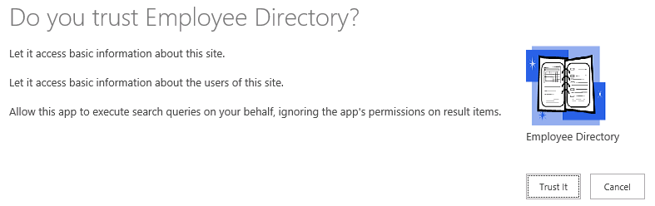
App Permissions
<AppPermissionRequest Scope=http://sharepoint/search
Right="QueryAsUserIgnoreAppPrincipal" />

Slide 34
Search Based Apps
Demo
https://github.com/OfficeDev/TrainingContent/tree/master/O3656-6%20Deep%20Dive%20into%20Search%20Scenarios%20in%20Office%20365/Demos/EmployeeDirectory

Slide 35
Recommendations
Exporting and importing search settings with CSOM
Out of the box capabilities can be easily extended
Display templates are really powerful
Remote APIs for customizations

Slide 36

Questions?

Slide 37

aka.ms/OfficeDevPnP
Transform your code
Providing App Model Patterns for common scenarios Open source and based on community contributions Constantly evolving set of material for reuse
100+ Visual Studio projects
Common scenarios Branding Site provisioning Remote event receivers
UX component Taxonomy driven navigation And much more…
Patterns and Practices Yammer Group - http://aka.ms/officedevpnpYammer

Slide 38
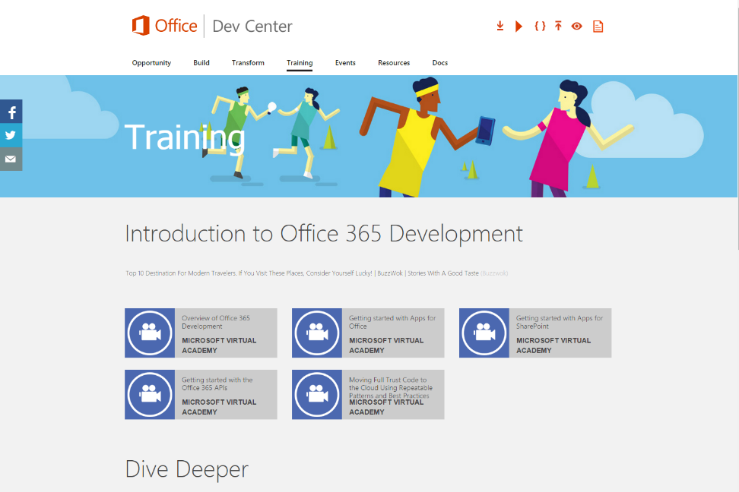
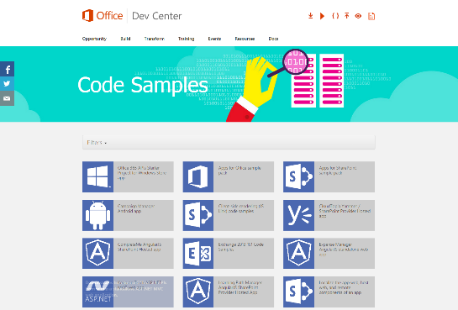
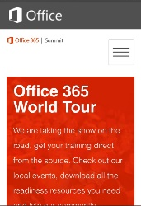
dev.office.com
Sign up
http://dev.office.com/getting-started
Explore
http://apisandbox.msdn.microsoft.com
Get trained http://dev.office.com/training

Slide 39


Feedback
Office 365 Network Share you best practices and join conversations
https://www.yammer.com/itpronetwork
Stackoverflow Ask deep technical questions to a world-wide set of developers
http://stackoverflow.com/questions/tagged/ms-office
UserVoice Provide suggestions of what you want in future versions
http://officespdev.uservoice.com/

Slide 40

© 2015 Microsoft Corporation. All rights reserved. Microsoft, Windows, Windows Vista and other product names are or may be registered trademarks and/or trademarks in the U.S. and/or other countries.
The information herein is for informational purposes only and represents the current view of Microsoft Corporation as of the date of this presentation. Because Microsoft must respond to changing market conditions, it should not be interpreted to be a commitment on the part of Microsoft, and Microsoft cannot guarantee the accuracy of any information provided after the date of this presentation. MICROSOFT MAKES NO WARRANTIES, EXPRESS, IMPLIED OR STATUTORY, AS TO THE INFORMATION IN THIS PRESENTATION.

